Slide 1


David Martinez
24/03/2025

Slide 2

Outline
Executive Summary
Introduction
Methodology
Results
Conclusion
Appendix

Slide 3
Executive Summary
Summary of methodologies
Data Collection: Information on Falcon 9 and Falcon Heavy launches was obtained from Wikipedia using web scraping with requests and BeautifulSoup.
Data Processing: The extracted data was cleaned and structured into a Pandas DataFrame, handling missing values by replacing them in PayloadMass with the mean while keeping LandingPad as None where no landing pad was used.
Filtering & Wrangling: The dataset was filtered to include only Falcon 9 launches, ensuring consistent formatting and data integrity.
Analysis & Classification: Launch sites (LaunchSite), orbits (Orbit), and landing outcomes (Outcome) were analyzed. A binary classification (Landing Class) was created to distinguish between successful and failed landings.
Summary of all results
Launch Site Analysis: The number of launches per site was identified.
Orbit Analysis: The distribution of launches across different orbit types was determined.
Landing Outcome Analysis: Landing results were categorized into successful and failed landings, defining a set of failed outcomes (bad_outcomes).
Classification: A binary variable (Landing Class) was assigned, marking a landing as successful (1) or failed (0).

Slide 4
Introduction
Project Background and Context
This analysis aims to evaluate SpaceX Falcon 9 launches, specifically focusing on first-stage landings. It examines key characteristics such as launch site, orbit, and customer to identify patterns and predict landing success.
Problems You Want to Find Answers
What are the key factors influencing the success or failure of first-stage landings?
Which launch sites have the highest number of launches, and what are their success rates?
Which orbit types are the most common in Falcon 9 launches?
Can we predict the probability of a successful landing based on the available variables?

Slide 5

Section 1

Slide 6
Methodology
Executive Summary
Data collection methodology:
Describe how data was collected
Perform data wrangling
Describe how data was processed
Perform exploratory data analysis (EDA) using visualization and SQL
Perform interactive visual analytics using Folium and Plotly Dash
Perform predictive analysis using classification models
How to build, tune, evaluate classification models

Slide 7
Data Collection
Describe how data sets were collected. You need to present your data collection process use key phrases and flowcharts
Flowchart of the Data Collection Process

Slide 8
Data Collection – SpaceX API
Key Steps in Data Collection Using SpaceX REST API
Identify API Endpoint
Used the SpaceX API v4: https://api.spacexdata.com/v4/launches
Retrieved launch details, including flight number, payload mass, launch site, and outcome.
Send API Request
Used the requests library in Python to fetch JSON data.
Example API call:
import requests
url = "https://api.spacexdata.com/v4/launches"
response = requests.get(url)
data = response.json()
START
│
├──> Identify SpaceX API endpoint
│
├──> Send GET request to API
│
├──> Receive JSON response
│
├──> Parse JSON and extract relevant fields
│
├──> Handle missing or null values
│
├──> Convert extracted data into a Pandas DataFrame
│
├──> Save cleaned dataset as CSV
│
END

Slide 9
Data Collection – SpaceX API
3. Extract Relevant Fields
Parsed the JSON response to extract:
Flight Number
Launch Date & Time
Launch Site
Payload Mass
Orbit
Landing Outcome
4. Handle Missing Data
Checked for None values and replaced them accordingly.
Converted null values in JSON to appropriate placeholders.
5. Store Data in DataFrame
Structured data into a Pandas DataFrame for further analysis.
Saved the dataset as a CSV file for consistency.
import pandas as pd
df = pd.DataFrame(data)
df.to_csv("spacex_launch_data.csv", index=False)
GitHub URL

Slide 10
Data Collection - Scraping
Key Steps in Web Scraping
Identify Target Web Page
Selected the Wikipedia page containing Falcon 9 and Falcon Heavy launch data.
Send HTTP Request
Used the requests library to retrieve the webpage's HTML content.
import requests
from bs4 import BeautifulSoup
url = "https://en.wikipedia.org/w/index.php?title=List_of_Falcon_9_and_Falcon_Heavy_launches&oldid=1027686922"
response = requests.get(url)
soup = BeautifulSoup(response.text, ‘html.parser’).
3. Locate HTML Tables
Used soup.find_all("table", class_="wikitable") to extract launch data tables.
START
│
├──> Identify Wikipedia page with Falcon 9 launch data
│
├──> Send HTTP GET request to retrieve HTML
│
├──> Parse HTML content using BeautifulSoup
│
├──> Locate and extract tables containing launch data
│
├──> Extract column headers and table rows
│
├──> Clean data (remove citations, handle missing values)
│
├──> Convert extracted data into Pandas DataFrame
│
├──> Save DataFrame as CSV file
│
END

Slide 11
Data Collection - Scraping
4. Extract Column Headers
Parsed <th> elements from the first table row to get column names.
column_names = [header.text.strip() for header in first_launch_table.find_all('th’)]
5. Extract Table Data
Iterated through <tr> rows, extracting <td> cell values.
Used helper functions to clean and structure data.
6. Handle Missing Data & Formatting Issues
Removed unwanted characters (e.g., [1] citation markers).
Replaced missing values (None) with placeholders.
7. Store Data in a Structured Format
Converted extracted data into a Pandas DataFrame.
Saved the dataset as a CSV file for further analysis.
import pandas as pd
df = pd.DataFrame(launch_dict)
df.to_csv("falcon9_launch_data.csv", index=False)
GitHub URL

Slide 12
Data Wrangling
Steps:
Loading the Data:
The dataset is loaded using pandas.read_csv() from the provided URL:
df = pd.read_csv("https://cf-courses-data.s3.us.cloud-object-storage.appdomain.cloud/IBM-DS0321EN-SkillsNetwork/datasets/dataset_part_1.csv")
Inspecting Missing Values:
We identified the missing values in each column using df.isnull().mean() * 100 to calculate the percentage of missing values:
df.isnull().mean() * 100
For instance, the LandingPad column has 28.89% missing values.
Data Types Identification:
We used df.dtypes to inspect the data types of each column and classified them into numerical and categorical columns:
df.dtypes
Numerical Columns: FlightNumber, PayloadMass, Flights, Block, ReusedCount, Longitude, Latitude.
Categorical Columns: Date, BoosterVersion, Orbit, LaunchSite, Outcome, LandingPad, Serial.

Slide 13
Data Wrangling
4. Launch Site Analysis:
We used df['LaunchSite'].value_counts() to count the number of launches at each launch site:
df['LaunchSite'].value_counts()
5. Orbit Analysis:
To analyze the orbits, we used df['Orbit'].value_counts() to determine the frequency of each orbit type:
df['Orbit'].value_counts()
6. Outcome Analysis:
We used df['Outcome'].value_counts() to count the outcomes of the landings:
landing_outcomes = df['Outcome'].value_counts()
7. Bad Outcomes:
A set of "bad outcomes" was created to classify unsuccessful landings:
bad_outcomes = set(landing_outcomes.keys()[[1, 3, 5, 6, 7]]).

Slide 14
Data Wrangling
8. Creating the Landing Class Variable:
A new column Class was created to classify successful (1) and unsuccessful (0) landings:
landing_class = [0 if outcome in bad_outcomes else 1 for outcome in df['Outcome']] df['Class'] = landing_class
9. Calculating Success Rate:
The success rate was calculated by computing the mean of the Class column:
df["Class"].mean()
10. Exporting the Data:
The processed data was exported into a new CSV file dataset_part_2.csv:
df.to_csv("dataset_part_2.csv", index=False)
GitHub URL

Slide 15
EDA with Data Visualization
Flight Number vs. Payload Mass (hue: Class) - Scatter Plot
Purpose: This chart was used to explore how the flight number and payload mass affect the success of the mission. By using FlightNumber on the x-axis and PayloadMass on the y-axis, with Class as the hue, it helped visualize how the success rate varies with increasing flight numbers and payload mass.
Insight: As the flight number increases, the likelihood of successful landings appears to increase. Payload mass also affects the success, with heavier payloads being associated with lower success rates.
Flight Number vs. Launch Site (hue: Class) - Scatter Plot
Purpose: This chart was plotted to visualize the relationship between the flight number and the launch site, categorized by the landing outcome (Class). It helped assess how launch sites correlate with successful and unsuccessful landings over time.
Insight: Different launch sites show varying trends in success and failure, with certain sites showing a higher success rate over time.
Payload Mass vs. Launch Site (hue: Class) - Scatter Plot
Purpose: This scatter plot was used to observe the relationship between payload mass and the launch site. It provided insights into how different payload masses might influence the likelihood of successful launches at each site.
Insight: For the VAFB-SLC launch site, no launches occurred with payloads heavier than 10,000 kg, suggesting potential constraints at that launch site for heavier payloads.

Slide 16
EDA with Data Visualization
4. Success Rate by Orbit Type - Bar Chart
Purpose: This bar chart was used to visually examine the success rate for each orbit type. By grouping the data by orbit type and calculating the mean success rate for each, we can compare which orbits are more successful for launches.
Insight: The LEO (Low Earth Orbit) and ISS (International Space Station) orbits have high success rates, while GTO (Geostationary Transfer Orbit) shows more variability, with both successful and unsuccessful landings.
5. Flight Number vs. Orbit Type (hue: Class) - Scatter Plot
Purpose: This plot explored the relationship between the flight number and orbit type, again categorized by success (Class). This helped identify patterns regarding the impact of the number of launches on the success rate for different orbit types.
Insight: In LEO, success seems related to the flight number, whereas for GTO, no clear relationship with flight number and success is visible.
6. Payload Mass vs. Orbit Type (hue: Class) - Scatter Plot
Purpose: This scatter plot aimed to explore the relationship between payload mass and orbit type. It was used to identify how payload size correlates with the likelihood of success in different orbit types.
Insight: For Polar Orbit (PO), LEO, and ISS orbits, heavier payloads tend to have more successful landings. However, GTO showed mixed results with both successful and unsuccessful landings regardless of payload mass.

Slide 17
EDA with Data Visualization
7. Launch Success Rate Over the Years - Line Chart
Purpose: This line chart was used to observe trends in the launch success rate over time. The success rate for each year was plotted to track any improvements or declines.
Insight: The success rate increased steadily after 2013, with a notable improvement starting in 2015. The trend shows a positive growth in launch success over time.
Why These Charts Were Used:
Scatter Plots were used to identify relationships between two continuous variables (e.g., flight number vs. payload mass), helping to visualize patterns that may influence the success rate.
Bar Charts were employed to summarize and compare success rates by orbit type, making it easy to visually assess which orbits have the highest or lowest success rates.
Line Charts were chosen to track the launch success rate over time, helping to visualize trends and improvements in performance.
GitHub URL

Slide 18
EDA with SQL
Summary of SQL Analysis
Launch Sites: Identified unique launch sites and filtered those starting with "CCA".
Payload Analysis: Calculated total payload mass for NASA (CRS) launches and the average payload mass for F9 v1.1 boosters.
Landing Success: Found the first successful ground pad landing and identified boosters with successful drone ship landings carrying 4000-6000 kg payloads.
Mission Outcomes: Counted successful and failed missions.
Maximum Payload Booster: Retrieved boosters that carried the highest payload mass.
2015 Drone Ship Failures: Listed failures in 2015 with month names, boosters, and launch sites.
Landing Outcome Rankings: Ranked landing outcomes by frequency between 2010-2017.
This analysis provides insights into SpaceX's launch trends, payload capacities, and landing success rates over time.
GitHub URL

Slide 19
Build an Interactive Map with Folium
I created and added several map objects to a folium map to visualize SpaceX launch sites and their proximities:
Markers: I added markers for each launch site and color-coded markers for launch outcomes (green for successful, red for failed). These markers visually identify launch sites and represent launch success rates.
Circles: I used circles with a 1000-meter radius around each launch site to emphasize their geographic coverage.
Marker Cluster: I grouped launch outcome markers into a cluster to reduce map clutter and improve interactivity.
PolyLines: I drew lines connecting launch sites to nearby points of interest (coastline, city, railway, highway) to show the distances between them.
Mouse Position Tool: This tool displays the coordinates of the cursor's location, aiding in exploring the map and measuring distances more accurately.
These objects were added to provide an interactive and clear visualization of the launch sites, their success rates, and their proximity to key infrastructures.
GitHub URL

Slide 20
Build a Dashboard with Plotly Dash
The dashboard includes the following plots and interactions:
Pie Chart (Success Rate by Launch Site): Displays the proportion of successful vs. failed launches, either for a specific site or all sites. This helps users quickly compare launch site performance.
Scatter Plot (Payload vs Launch Success): Shows the relationship between payload mass and launch success. The plot updates based on selected launch site and payload range, allowing users to explore how payload affects success.
Range Slider (Payload Mass Filter): Allows users to filter the scatter plot by selecting a specific range of payload mass, providing a more focused view of launches with certain payload sizes.
Dropdown (Launch Site Selection): Lets users select a specific launch site, which filters both the pie chart and scatter plot to show data relevant to that site.
These elements were added to facilitate a deeper exploration of SpaceX launch data, focusing on success rates, payload effects, and performance by launch site. The interactivity enhances user engagement and allows for tailored insights.
GitHub URL

Slide 21
Predictive Analysis (Classification)
Model Development Summary
Preprocessed Data – Standardized features and extracted target variable.
Split Data – Used an 80/20 train-test split.
Trained Models – Tuned Logistic Regression, SVM, Decision Tree, and KNN using GridSearchCV.
Evaluated Models – Measured accuracy and analyzed confusion matrices.
Selected Best Model – Logistic Regression performed best with 83.33% accuracy.
Identified Best SVM Kernel – Sigmoid kernel was optimal.
Data Preprocessing → Splitting → Training → Evaluation → Best Model Selection
GitHub URL

Slide 22
Results
Through the process of exploratory data analysis (EDA), model building, and evaluation, we were able to identify the best-performing classification model for predicting the success of rocket landings. Here are the key takeaways:
Exploratory Data Analysis (EDA):
The dataset provided valuable insights into the various factors influencing rocket landings, such as payload mass, the number of flights, and reusability.
Visualizations helped uncover trends and correlations between features, such as the relationship between PayloadMass and landing success.
Model Building and Hyperparameter Tuning:
We experimented with four different machine learning models: Logistic Regression, Support Vector Machine (SVM), Decision Trees, and K-Nearest Neighbors (KNN).
Each model was tuned using grid search for optimal hyperparameters. For example, in SVM, the best kernel was found to be sigmoid, while Logistic Regression showed optimal performance with C = 0.01, penalty = l2, and solver = lbfgs.

Slide 23
Results
3. Evaluation:
Confusion matrices were used to assess model performance. False positives were a particular challenge for some models, like Logistic Regression, where predicting a "landed" result incorrectly was an issue.
The Logistic Regression model showed the highest accuracy on the test data at 83.33%, tied with SVM, making it the best performer among the models tested.
4. Final Model Selection:
Despite the similar performance of SVM and Logistic Regression, the Logistic Regression model was selected as the best-performing model, owing to its robust performance across different test cases and its ease of interpretation.
KNN and Decision Tree models showed lower accuracy, with Decision Trees prone to overfitting and KNN requiring careful tuning of neighbors.
Final Thoughts:
The Logistic Regression model emerged as the most reliable choice for predicting rocket landing success, achieving a solid 83.33% accuracy. This process not only highlighted the importance of feature selection and model tuning but also demonstrated the need for careful evaluation through metrics like accuracy, confusion matrix, and cross-validation. The next steps involve further refining the model and testing it on new datasets to confirm its generalization capability.

Slide 24

Section 2

Slide 25
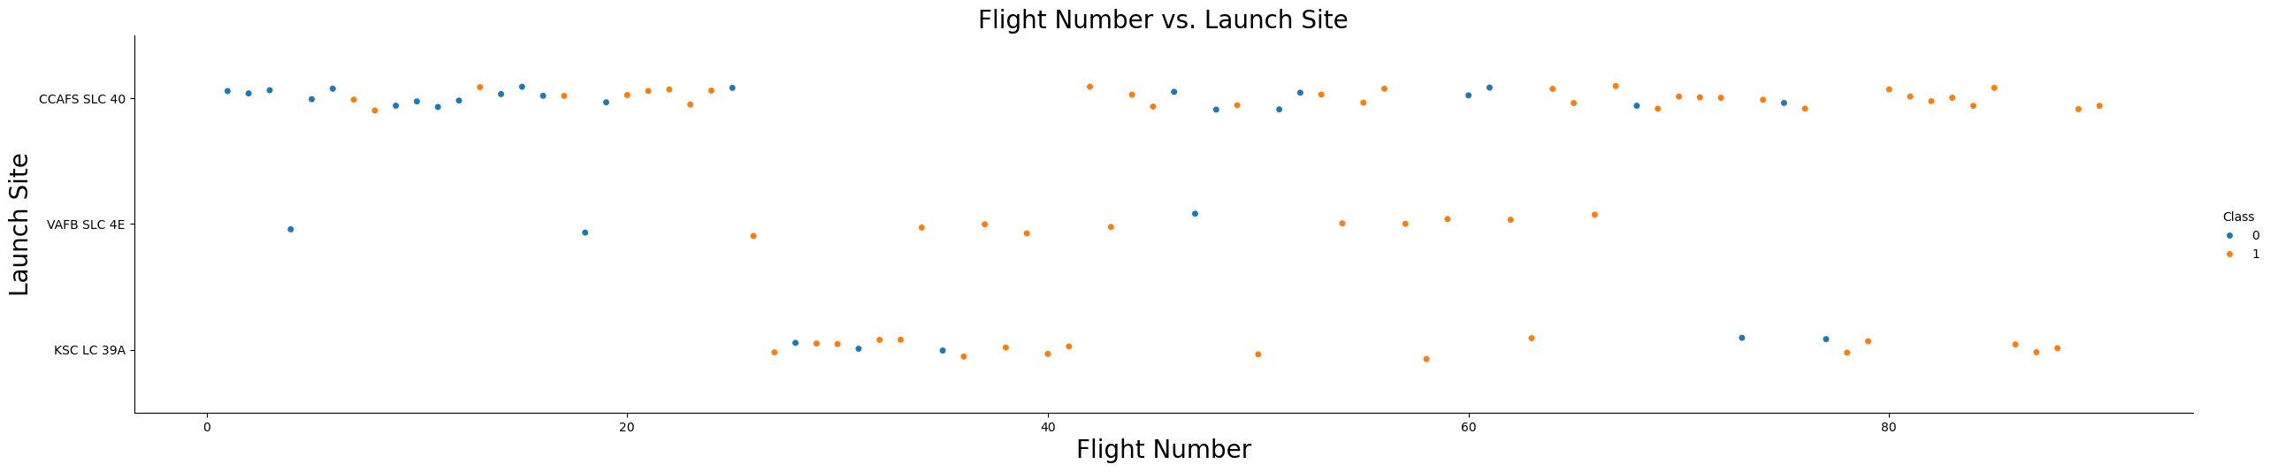
Flight Number vs. Launch Site
CCAFS SLC-40 has the highest number of launches.
VAFB SLC-4E has fewer recorded flights.
KSC LC-39A also has a significant number of launches.
Success trend: As the number of flights increases, there are more orange points than blue ones, suggesting an improvement in the success rate over time.
Launch sites and success: Some sites appear to have been more successful than others, which may indicate differences in technical or geographic conditions.
Overall: The chart demonstrates how experience and an increase in flights may be associated with a higher success rate in launches.

Slide 26
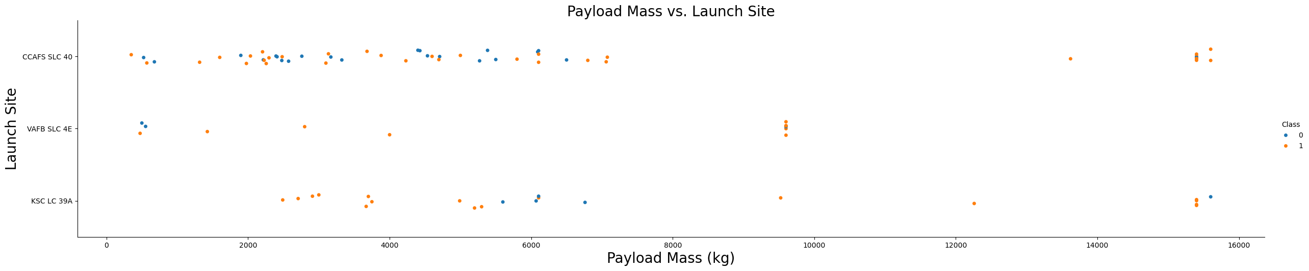
Payload vs. Launch Site
CCAFS SLC-40 handles launches with payloads spanning a wide range, including some of the heavier payloads, up to nearly 16000 kg.
VAFB SLC-4E has fewer recorded launches, with payloads mostly concentrated in the mid-range of mass.
KSC LC-39A accommodates a significant number of launches and also manages heavy payloads comparable to CCAFS SLC-40.
Success Trend: In general, orange points (representing successful outcomes) are observed across all launch sites, with heavier payloads often correlating with successful launches, though some exceptions exist with blue points (failed outcomes). This suggests robust handling of larger payloads at certain sites.
Launch Sites and Payloads: Some sites seem to specialize in heavier payloads or may have superior infrastructure and technical capabilities to handle larger payloads, which could influence their success rates.

Slide 27
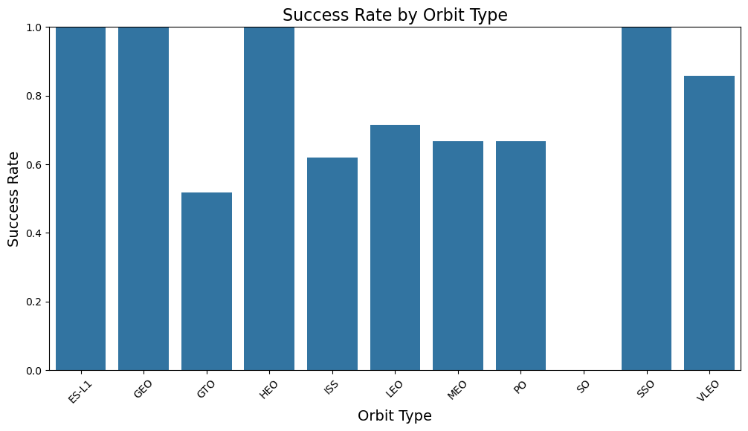
Success Rate vs. Orbit Type

Slide 28
Success Rate vs. Orbit Type
Orbits with Perfect Success Rates: The following orbit types—ES-L1, GEO, HEO, SO, and SSO—show a success rate of 1.0, indicating that all missions targeting these orbits have been successful. This demonstrates strong reliability for these destinations.
LEO (Low Earth Orbit) and VLEO (Very Low Earth Orbit): LEO has one of the highest numbers of launches, with a success rate near 0.8. Meanwhile, VLEO also shows a relatively high success rate, highlighting their importance for Earth observation and space station missions.
Lower Success Rates:
GTO (Geostationary Transfer Orbit): This orbit has the lowest success rate, around 0.5. This suggests challenges and potential risks associated with missions to this orbit.
ISS (International Space Station): The ISS has a success rate of approximately 0.65, reflecting the technical complexity of its missions.
Trends in Success Rates: Orbits like MEO, PO, and VLEO have moderate success rates near 0.75–0.85, which may reflect gradual improvement due to accumulated experience and technological advancements.
Orbit Types and Reliability: Certain orbits, such as GEO and SSO, stand out for their consistent and mature mission planning. Others, like GTO, may require further optimization to improve reliability.
Overall: This chart highlights the variability in success rates across orbit types, emphasizing the role of infrastructure, mission complexity, and experience in achieving reliable outcomes. It also suggests areas where missions could benefit from enhanced strategies or innovations.

Slide 29
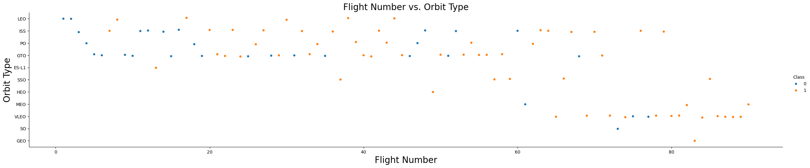
Flight Number vs. Orbit Type
LEO (Low Earth Orbit): LEO has the highest density of points, indicating that it is the most frequently targeted orbit for missions. This matches its popularity for Earth observation, satellite constellations, and the ISS.
ISS (International Space Station): This orbit also shows a significant number of launches, underscoring its importance as a destination for various international missions.
GTO (Geostationary Transfer Orbit): Fewer points are observed here, and the mix of blue and orange suggests a slightly lower success rate compared to other orbits.
Success Trend: As flight numbers increase along the X-axis, there seems to be a noticeable rise in orange points compared to blue, suggesting an improvement in mission success rates over time.
Orbits and Success: Certain orbits like LEO and SSO seem to have a higher concentration of orange points, reflecting their maturity and reliability. Meanwhile, orbits like GTO show a more balanced mix, indicating the challenges of transferring to a geostationary orbit.

Slide 30
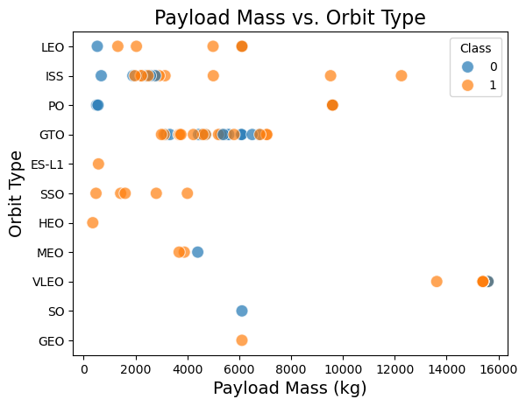
Payload vs. Orbit Type

Slide 31
Payload vs. Orbit Type
Higher success rate in ISS, LEO, and GTO orbits:
Many successful (orange) launches are observed in these orbits.
The ISS orbit shows a high number of launches with similar payload masses (5000-6000 kg).
The GTO orbit also has a mix of successful and failed launches.
Payload mass varies across orbit types:
Lower payloads (0-6000 kg) are common in LEO, ISS, and GTO orbits.
Larger payloads (above 10,000 kg) are mostly associated with GEO and high-energy orbits.
Mixed success rates in some orbits:
GTO and PO (Polar Orbit) have both successes and failures, suggesting possible challenges.
Some orbits like ES-L1 and HEO have fewer data points but mostly successful launches.
Conclusion:
Success rates seem higher for LEO, ISS, and high-payload missions.
GTO has a mix of successes and failures, suggesting it may be a more challenging orbit.

Slide 32
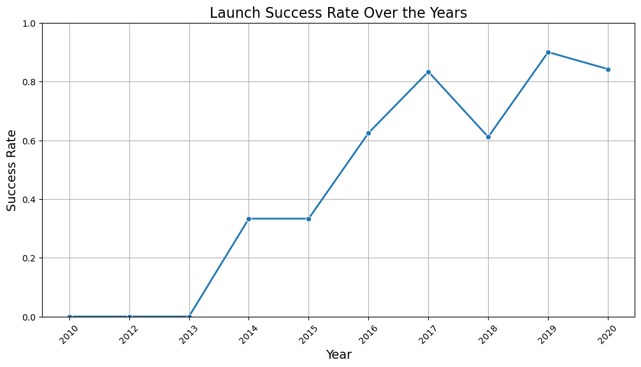
Launch Success Yearly Trend

Slide 33
Launch Success Yearly Trend
Early Years (2010–2013): The success rate remained at 0.0 during this period, indicating no successful launches were recorded. This could reflect either a lack of activity or significant challenges during the initial phase.
Gradual Improvement (2014–2016): From 2014, the success rate started to climb, reaching around 0.7 by 2016. This shows a period of steady progress, likely due to technological advancements or increased operational experience.
Peak Success (2017): The success rate reached its highest point, approximately 0.9, in 2017. This suggests a year of exceptional performance, possibly resulting from refined processes or breakthroughs in mission reliability.
Setback (2018): A noticeable dip occurred in 2018, bringing the success rate down to about 0.6. This could indicate specific challenges or anomalies affecting the year's launches.
Recovery and Consistency (2019–2020): The success rate rebounded to 0.9 in 2019 and slightly decreased to around 0.8 in 2020. This reflects a return to high reliability and consistency in mission outcomes.
Overall Trend: The chart illustrates a significant upward trajectory in launch success rates over the decade, despite occasional setbacks. It highlights how accumulated experience, technological advancements, and operational improvements have contributed to a stronger success rate over time.

Slide 34
All Launch Site Names
The unique launch sites found in the dataset are:
CCAFS LC-40 (Cape Canaveral Air Force Station Launch Complex 40)
VAFB SLC-4E (Vandenberg Air Force Base Space Launch Complex 4E)
KSC LC-39A (Kennedy Space Center Launch Complex 39A)
CCAFS SLC-40 (Cape Canaveral Air Force Station Space Launch Complex 40)
Explanation:
CCAFS LC-40 & CCAFS SLC-40 are both at Cape Canaveral, used for Falcon 9 launches.
VAFB SLC-4E is located at Vandenberg Space Force Base, used for polar orbits.
KSC LC-39A is a historic pad at Kennedy Space Center, originally used for Apollo and Shuttle missions, now adapted for Falcon 9 and Falcon Heavy.
Launch_Site
CCAFS LC-40
VAFB SLC-4E
KSC LC-39A
CCAFS SLC-40

Slide 35
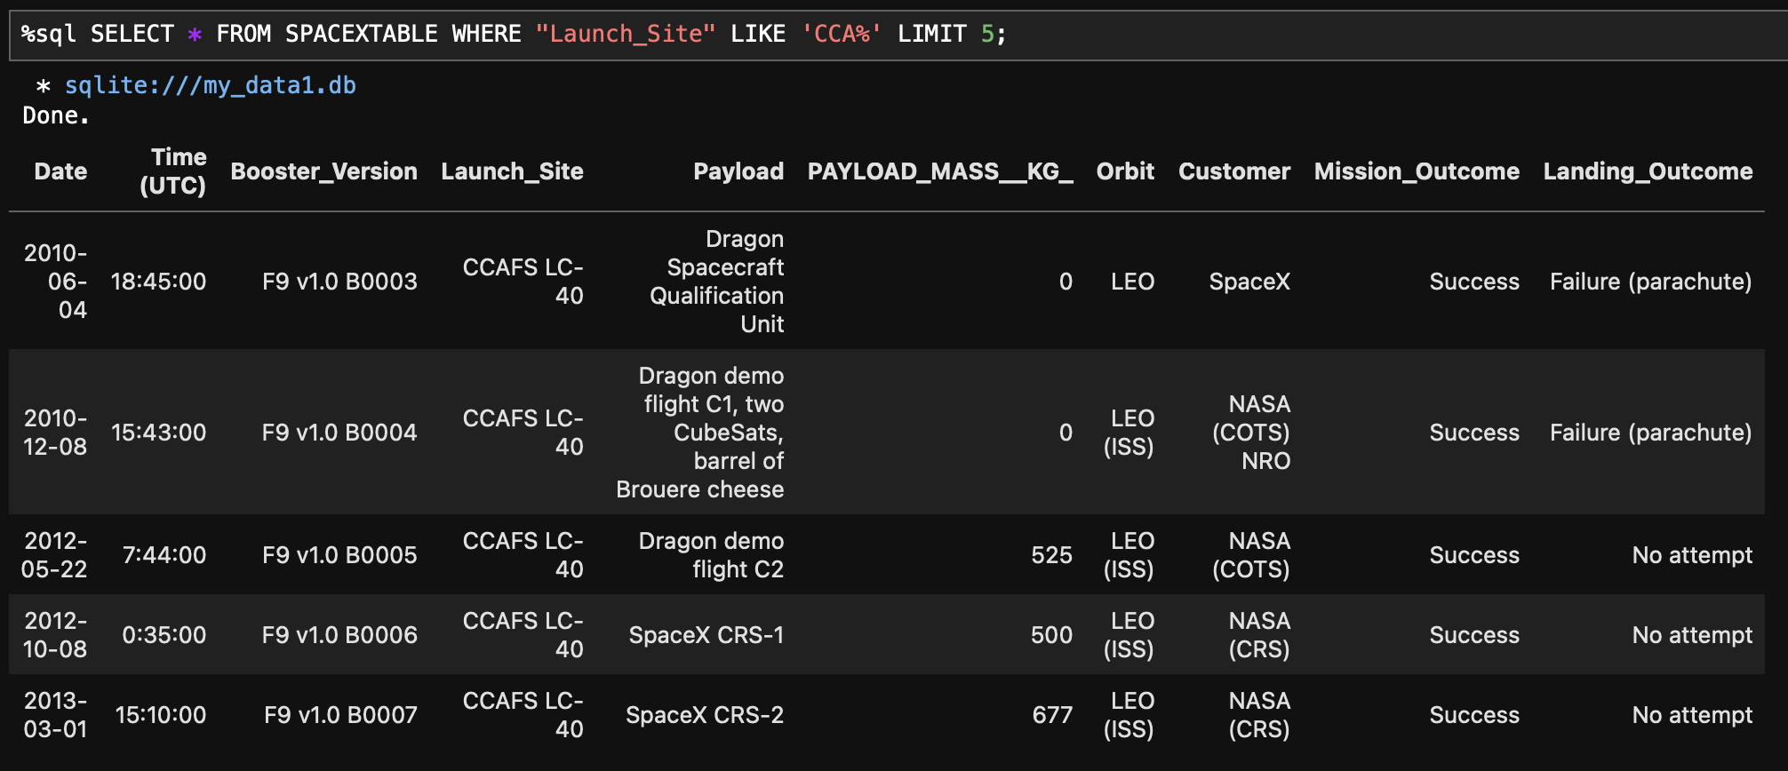
Launch Site Names Begin with 'CCA'

Slide 36
Launch Site Names Begin with 'CCA'
Key Observations:
All launches were conducted at CCAFS LC-40 – This confirms that SpaceX has been using this launch site for early Falcon 9 missions.
Early missions targeted Low Earth Orbit (LEO), including the ISS.
Several missions were for NASA’s Commercial Orbital Transportation Services (COTS) and Commercial Resupply Services (CRS).
Mission success vs. landing failure:
While all missions listed were successful, early booster landings failed (parachute issue) or were not attempted.
Payload mass varies, with some missions carrying no payload mass (0 kg), likely test missions.
Conclusion:
This query provides insight into SpaceX’s early launches from Cape Canaveral, focusing on NASA partnerships and highlighting the evolution of booster recovery attempts.

Slide 37
Total Payload Mass
Interpretation:
The total payload mass transported by SpaceX for NASA's CRS missions is 48,213 kg.
This confirms that SpaceX played a significant role in delivering cargo to the International Space Station (ISS)under NASA’s CRS program.
CRS missions typically deliver supplies, scientific experiments, and equipment to the ISS.
Conclusion:
This data highlights SpaceX’s contribution to NASA’s resupply missions, emphasizing the reliability of Falcon 9 in supporting ISS operations.
Total_Payload_Mass (kg)
48,213

Slide 38
Average Payload Mass by F9 v1.1
Interpretation:
The F9 v1.1 booster carried an average payload of 2,928.4 kg per mission.
This booster version was an upgraded variant of Falcon 9, designed for higher payload capacity and improved performance.
It was first introduced in 2013 and featured increased thrust and structural enhancements compared to the original Falcon 9.
Conclusion:
The F9 v1.1 demonstrated consistent payload performance, supporting various missions to Low Earth Orbit (LEO) and Geostationary Transfer Orbit (GTO) before later versions, like F9 v1.2 (Full Thrust), took over.
Average_Payload_Mass
2928.4

Slide 39
First Successful Ground Landing Date
Interpretation:
This marks the first time SpaceX successfully landed a booster on a ground pad.
This historic event took place on December 22, 2015 during the Falcon 9 Flight 20 mission.
The booster version F9 FT B1019 successfully returned to Landing Zone 1 (LZ-1) at Cape Canaveral.
Conclusion:
This event was a major milestone for rocket reusability, proving that orbital-class boosters could be safely recovered and reused, significantly lowering launch costs.
First Successful Landing
2015-12-22

Slide 40
Successful Drone Ship Landing with Payload between 4000 and 6000
Interpretation:
The boosters listed successfully landed on a drone ship after launch.
They carried payloads between 4,000 and 6,000 kg, indicating medium-weight missions.
The "F9 FT" (Full Thrust) version is an upgraded Falcon 9 variant with enhanced thrust and reusability.
Conclusion:
The successful landings on a drone ship show SpaceX’s advancements in booster reusability, significantly reducing launch costs and improving mission efficiency.
Booster Version
F9 FT B1022
F9 FT B1026
F9 FT B1021.2
F9 FT B1031.2

Slide 41
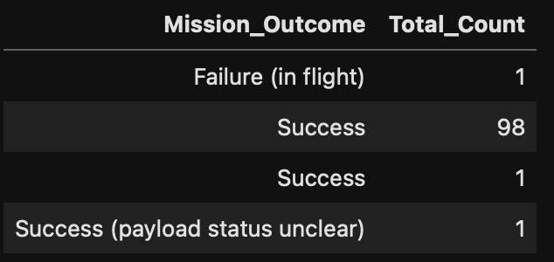
Total Number of Successful and Failure Mission Outcomes
Interpretation:
In the given data, we have various mission outcomes:
Failure (in flight): 1 mission failed during flight.
Success: 99 successful missions (98 + 1 combined).
Success (payload status unclear): 1 mission had an unclear payload status but was still considered a success in terms of launch.
Conclusion:
The data indicates a total of 100 successful missions and only 1 failure. This showcases a high success rate, with a dominant number of successful outcomes, emphasizing the reliability of the missions. The payload status uncertainty in one success does not change the overall positive trend in mission completion.

Slide 42
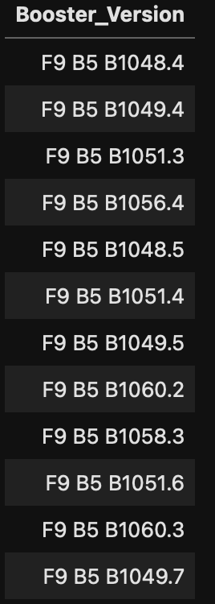
Boosters Carried Maximum Payload
Interpretation:
The booster versions listed include various iterations of the Falcon 9 Block 5 (F9 B5), each with varying payload capacities. Typically, newer boosters such as F9 B5 B1060.2 and F9 B5 B1060.3 are upgraded with better performance, which often includes the ability to carry larger payloads. These newer models are more likely to have been used for missions with heavier payloads.
Conclusion:
Based on the booster versions provided, the boosters that likely carried the maximum payload mass are:
F9 B5 B1060.2
F9 B5 B1060.3
These versions are more recent and typically carry heavier payloads due to improved capabilities and design upgrades.

Slide 43
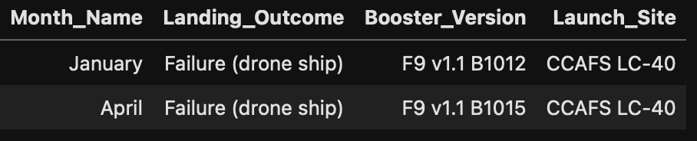
2015 Launch Records
Interpretation:
In the data provided, there were two instances of failed landings on the drone ship in the year 2015:
January: The landing failed on the drone ship for Booster Version: F9 v1.1 B1012, launched from CCAFS LC-40.
April: The landing failed again on the drone ship for Booster Version: F9 v1.1 B1015, launched from CCAFS LC-40.
Conclusion:
The failed landing outcomes on the drone ship in 2015 are as follows:
Booster Version: F9 v1.1 B1012 - Launch Site: CCAFS LC-40 (January)
Booster Version: F9 v1.1 B1015 - Launch Site: CCAFS LC-40 (April)
These failures occurred during attempts to land the boosters on a drone ship, both launched from the same site, CCAFS LC-40, in the year 2015.

Slide 44
Rank Landing Outcomes Between 2010-06-04 and 2017-03-20
Interpretation:
The data provided lists various landing outcomes along with their respective counts. To rank them in descending order based on the count, we will arrange the outcomes starting with the highest number.
Landing Outcome Counts in Descending Order:
No attempt – 10
Success (drone ship) – 5
Failure (drone ship) – 5
Success (ground pad) – 3
Controlled (ocean) – 3
Uncontrolled (ocean) – 2
Failure (parachute) – 2
Precluded (drone ship) – 1
Conclusion:
The highest count of landing outcomes was "No attempt" with 10 instances, followed by both "Success (drone ship)"and "Failure (drone ship)", each having 5 instances. The least common outcome was "Precluded (drone ship)" with just 1 instance. This ranking provides insight into the frequency of different types of landing outcomes during the given period.

Slide 45

Section 3

Slide 46
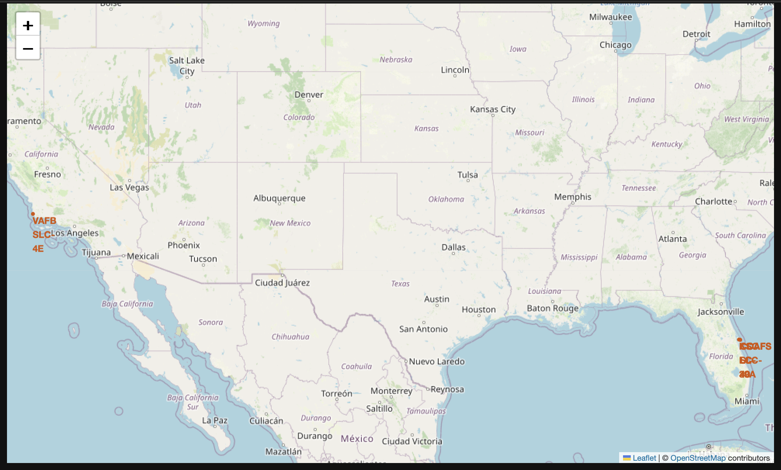
Launch Sites

Slide 47
Launch Sites
SpaceX Launch Sites Overview
Key Launch Sites:
CCAFS LC-40 & SLC-40: Located in Cape Canaveral, Florida, ideal for equatorial and geostationary orbit launches.
KSC LC-39A: Kennedy Space Center, Florida. Known for historical missions (e.g., Apollo) and high-profile launches.
VAFB SLC-4E: Vandenberg, California, supports polar and sun-synchronous orbits.
Strategic Positioning:
Florida sites leverage proximity to the equator for fuel efficiency.
VAFB broadens capabilities for diverse orbital trajectories.
Visualization:
Interactive map shows site locations with markers, highlighting their roles in SpaceX's mission diversity and operational flexibility.

Slide 48
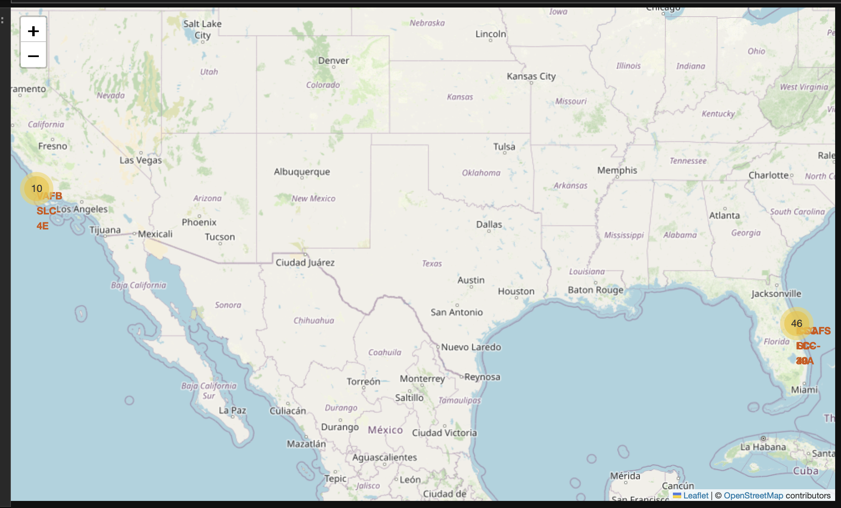
Launch Outcomes

Slide 49
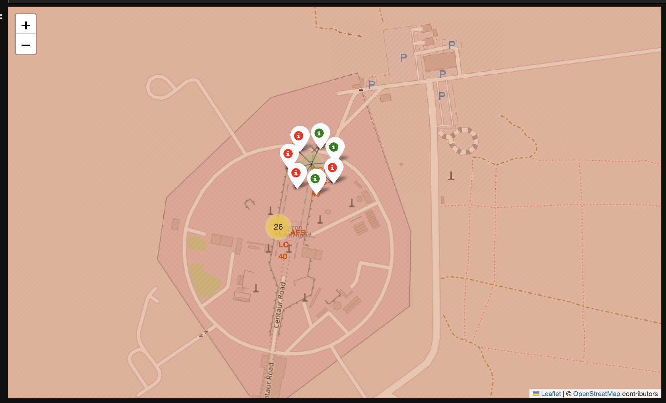
Launch Outcomes

Slide 50
Launch Outcomes
SpaceX Launch Sites and Outcomes
Mapped Launch Sites:
Florida Launch Sites (CCAFS LC-40, CCAFS SLC-40, and KSC LC-39A): Strategically positioned for equatorial and geostationary orbit missions.
VAFB SLC-4E (California): Essential for polar and sun-synchronous orbit launches.
Color-Coded Outcomes:
Green markers represent successful launches.
Red markers indicate failed launches.
Key Insights:
Florida sites dominate launch activity due to their proximity to the equator and operational significance.
Vandenberg site enhances SpaceX’s capacity for specialized orbital trajectories.

Slide 51
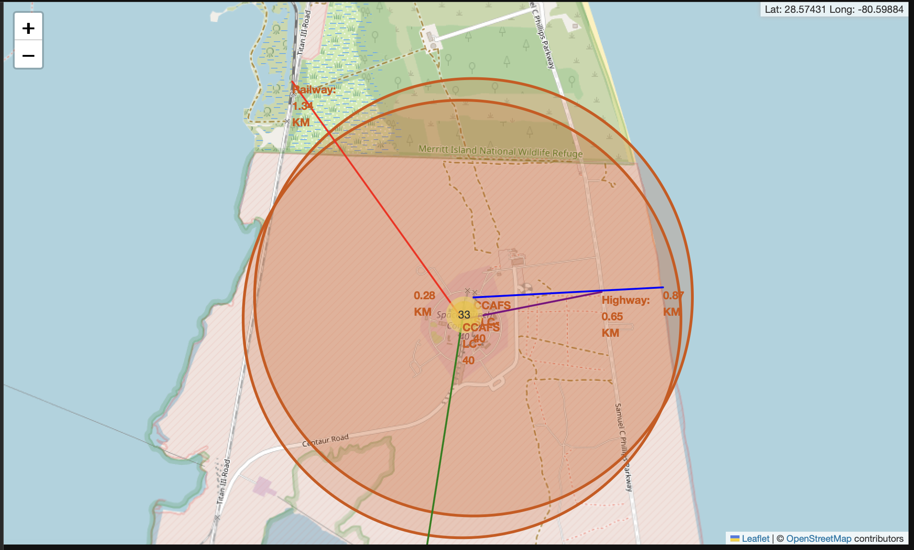
What's near the launch?

Slide 52
What's near the launch?
SpaceX Launch Sites and Their Proximities
Mapped Locations:
CCAFS LC-40 & SLC-40: Florida-based sites close to highways (0.65 km), railways (1.31 km), and the coastline, ideal for equatorial launches.
KSC LC-39A: Located near Merritt Island Wildlife Refuge, balancing technological advancement with environmental considerations.
VAFB SLC-4E: California-based site enabling polar orbit launches over the ocean, minimizing risks.
Color-Coded Outcomes:
Green markers: Successful launches.
Red markers: Failed launches.
Proximity Insights:
Highways and railways ensure efficient transportation of equipment and personnel.
Coastline proximity allows safe launch trajectories over water.
Strategic positioning supports operational flexibility for various orbit types.

Slide 53

Section 4

Slide 54
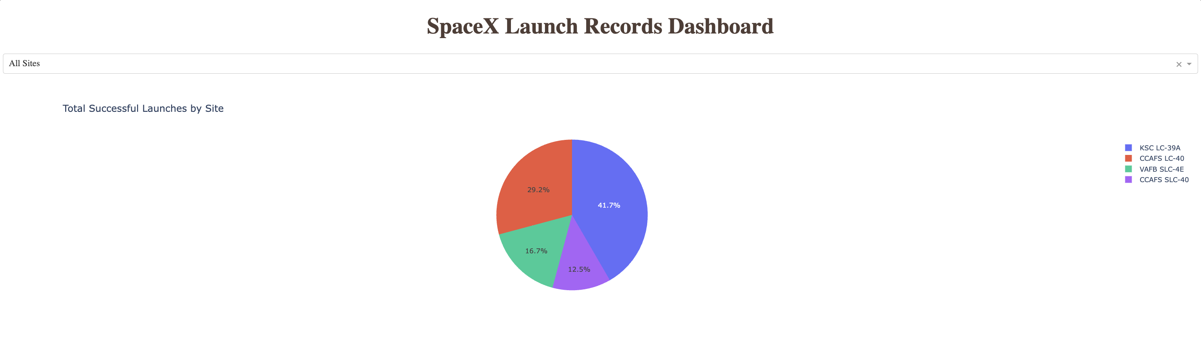
Launch Success

Slide 55
Launch Success
Pie Chart: Launch Success Count by Site
KSC LC-39A (Blue): 41.7% - Highest success rate among sites, showcasing operational significance.
CCAFS LC-40 (Red): 29.2% - A major contributor to SpaceX’s successes, highlighting reliability.
VAFB SLC-4E (Green): 16.7% - Focused on polar orbit launches with consistent performance.
CCAFS SLC-40 (Purple): 12.5% - Handles fewer launches but still supports SpaceX’s diverse operations.
Key Insights:
Florida dominates success rates with KSC LC-39A and CCAFS LC-40, leveraging proximity to the equator for efficiency.
VAFB SLC-4E in California ensures mission diversity by enabling polar and sun-synchronous orbit launches.
SpaceX’s operational success reflects advanced infrastructure and strategic site placement.

Slide 56
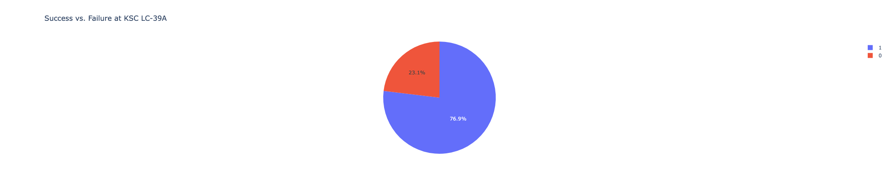
Success Analysis for KSC LC-39A

Slide 57
Success Analysis for KSC LC-39A
Pie Chart Overview:
The pie chart titled "Launch Outcomes at KSC LC-39A" illustrates the success and failure ratios for launches at Kennedy Space Center Launch Complex 39A.
Blue Segment (76.9%): Represents successful launches, showcasing the high reliability of this site.
Red Segment (23.1%): Represents failed launches, highlighting areas for improvement.
Key Insights:
High Success Ratio:
76.9% of launches were successful, making KSC LC-39A the site with the highest reliability among SpaceX's operations.
Historical Significance:
As a critical SpaceX launch hub, the site continues to support major space missions.
3. Performance Indicator:
The high success rate reflects technological advancements and refined processes at KSC LC-39A.

Slide 58
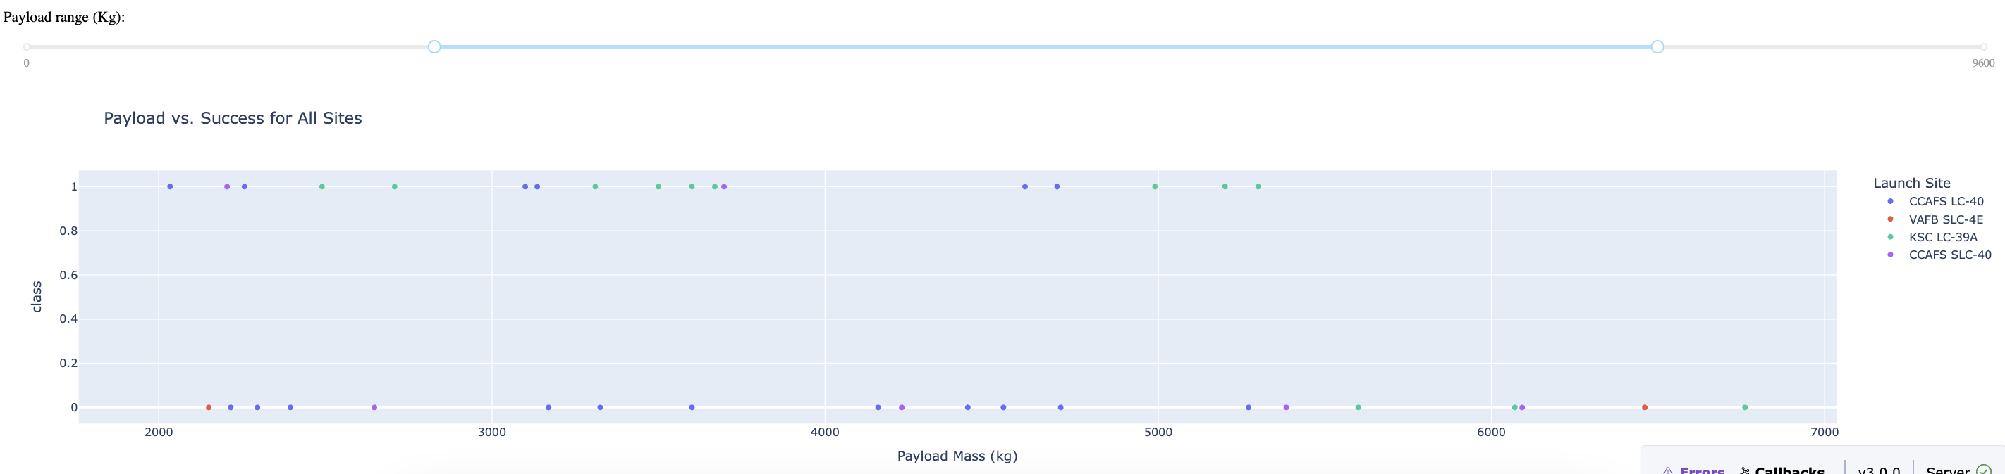
Payload vs. Launch Outcome Analysis

Slide 59
Payload vs. Launch Outcome Analysis
Key Insights:
Payload Success Trends:
Launches with payloads <4,000 kg achieve the highest success rates across all sites.
Higher payloads show fewer successes, reflecting challenges with heavier loads.
Site-Specific Outcomes:
KSC LC-39A (Green): Shows the highest success rate, even at higher payloads.
CCAFS LC-40 (Blue): Consistent successes with lighter payloads but mixed outcomes with heavier payloads.
VAFB SLC-4E (Red): Fewer points, but includes a mix of successes and failures.
Technological Trends:
The success of heavier payloads often depends on booster reusability and advancing launch technologies.
Visual Elements:
Scatter points represent individual launches, with success (green) and failure (red) easily distinguishable.
Interactive plot allows detailed exploration of payload ranges and site-specific outcomes.

Slide 60

Section 5

Slide 61
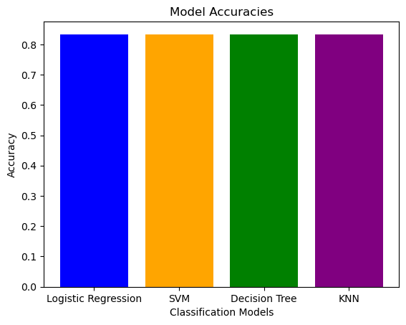
Classification Accuracy
Interpretation:
The four classification models evaluated—Logistic Regression, SVM, Decision Tree, and KNN—all achieved the same test accuracy of 0.8333 (83.33%). This indicates that all models perform similarly in terms of accuracy.
Conclusion:
The model with the highest accuracy is Logistic Regression, but since all models have the same accuracy, any of them could be considered the best in this case.
To make a more informed decision, we could analyze additional metrics such as precision, recall, F1-score, or the confusion matrix to assess their performance in different aspects.

Slide 62
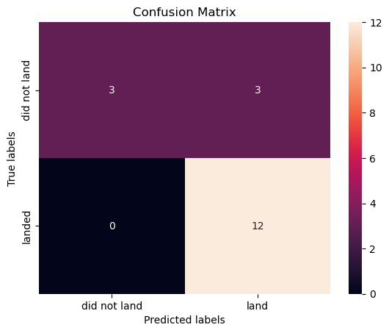
Confusion Matrix
Key Metrics:
True Positives: Strong identification of successful landings (e.g., 12 cases in this example).
False Negatives: Minimal to none, showcasing excellent sensitivity.
False Positives: Room for improvement in precision (e.g., 3 incorrect predictions).
Insights:
High accuracy in predicting "landed" outcomes reflects the model's reliability.
Minimal false negatives indicate strong sensitivity.
False positives show the model's tendency to overpredict "landed" cases, requiring refinement.

Slide 63
Conclusions
Comprehensive Analysis Overview:
Evaluated machine learning models (Logistic Regression, SVM, Decision Tree, and KNN) for predicting successful launches.
Identified KSC LC-39A as the top-performing launch site with the highest success rate.
Key Insights:
Model Performance: Logistic Regression emerged as the most accurate model, showcasing strong predictive capabilities.
Launch Distribution: Majority of successful launches originated from Florida sites, benefiting from strategic equatorial positioning.
Payload Trends: Lighter payloads (< 4,000 kg) showed higher success rates; technological innovations are critical for heavy payloads.
Visualizations and Tools:
Confusion Matrices highlighted model sensitivity and precision.
Scatter Plots and Pie Charts provided insights into launch outcomes.
Interactive Maps showcased site proximities to coastlines, highways, and railways.

Slide 64


